Slide 1
Liver Disease Prediction and Analysis
Farah Tabassum Ahmed
1610431042

Slide 2
Introduction
Patients with Liver disease have been continuously increasing because of excessive consumption of alcohol, inhale of harmful gases, intake of contaminated food, pickles and drugs. This dataset was used to evaluate prediction algorithms in an effort to reduce burden on doctors.

Slide 3
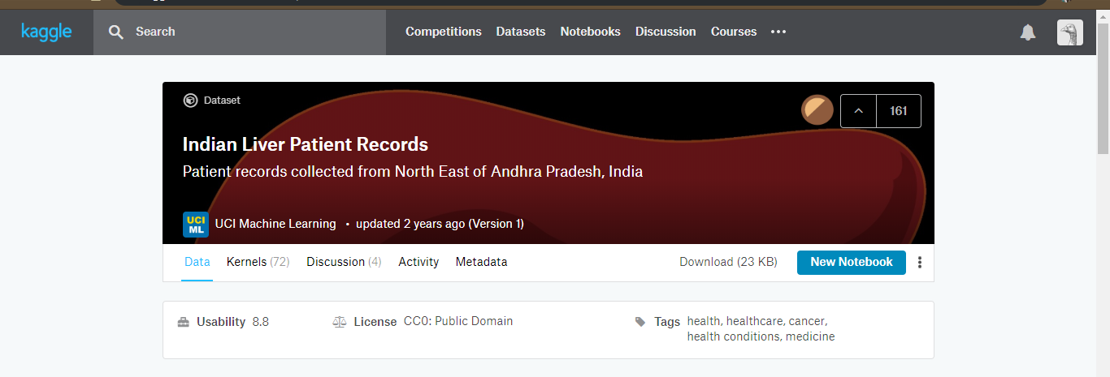
Dataset

Slide 4
Dataset
This dataset contains –
583 instances with 11 attributes.
441 male patient records and 142 female patient records.
416 liver patient records and 167 non liver patient records

Slide 5
Attribute Details
Columns:
Age of the patient
Gender of the patient
Total Bilirubin
Direct Bilirubin
Alkaline Phosphotase
Alamine Aminotransferase
Aspartate Aminotransferase
Total Protiens
Albumin
Albumin and Globulin Ratio
Dataset: field used to split the data into two sets (patient with liver disease, or no disease)

Slide 6
Objective
Goal of this project was to build classifiers to predict whether a person(male/female) has a liver disease
In this case, I will have the target variable “Dataset (the predicted attribute)”.
i. Dataset = Value 1; means the person has liver disease
ii. Dataset = Value 2; the person does not have liver disease

Slide 7
Works Update( After MID )
EDA (Exploratory data analysis)
Implemented some classifiers
Random Forest
Logistic Regression
Support Vector Machine
k-nearest neighbour
Artificial neural network

Slide 8
Classifiers Accuracy Result
Logistic Regression
Random Forest
Train | Test
73.5 | 71.59
Train | Test
100 | 72.0
Support Vector Machine
Train | Test
100 | 70.0

Slide 9
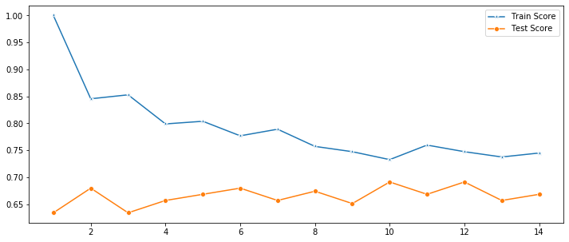
Classifiers Accuracy Result
k-Nearest Neighbour
Train | Test
81 | 79.63

Slide 10
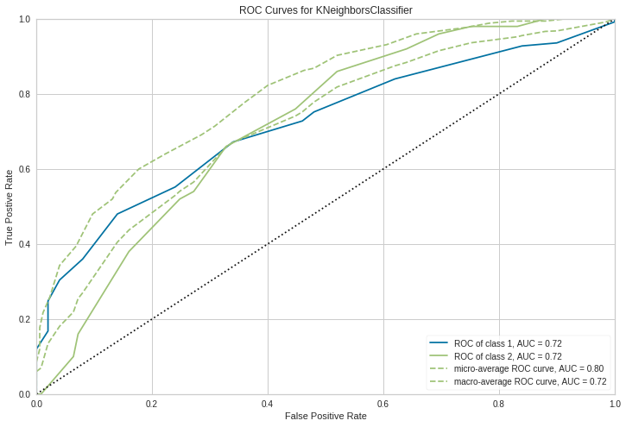

Slide 11
Classifiers Accuracy Result
Artificial Neural Network
Accuracy: 71.35506005475288
The Best Classifier among all of them is k-NN and the best result is captured at k=12. Hence it is used for the final model.

Slide 12
Thank you

